Slide 1
Components of Computer Networks
UNIT TWO

Slide 2
Introduction
The key parts that are required to install a network are included in the components of the Computer network. From simple to complex there are numerous types of networks in Computer networks. The components that we need to install for a network mainly depend upon the type of Network. We can also remove some network components according to our needs.
For example: In order to establish a wireless network there is no need for cables.

Slide 3
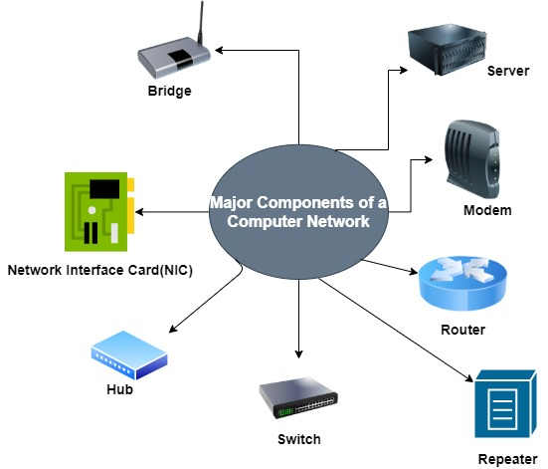
Components of a Computer Network:

Slide 4
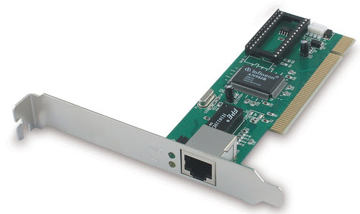
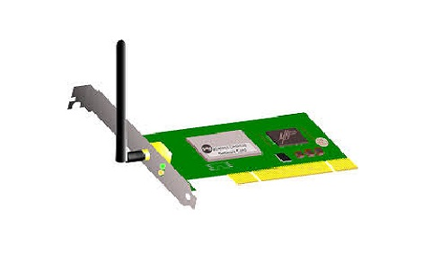
Network Interface Card(NIC)
NIC mainly provide the physical interface between computer and cabling. NIC prepares data, sends the data, and controls the flow of data. It can also receive and translate the data into bytes for the CPU to understand.
Wire NIC Wireless NIC

Slide 5
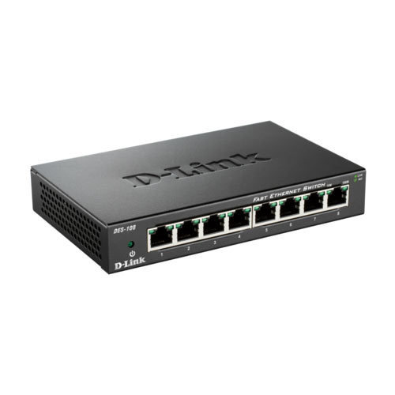
Hub
Hubs are those devices that are used to link several computers together. Hubs repeat one signal that comes in on one port and then copies it to other ports.

Slide 6
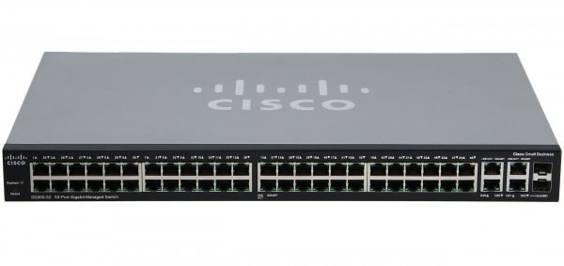
Switch
A network switch connects devices (such as computers, printers, wireless access points) in a network to each other, and allows them to ‘talk’ by exchanging data packets.
By intelligent we mean the decision-making ability of the switch. As hub works in the way by sending data to all ports on the device, whereas the switch sends the data to only that port that is connected with the destination device.

Slide 7
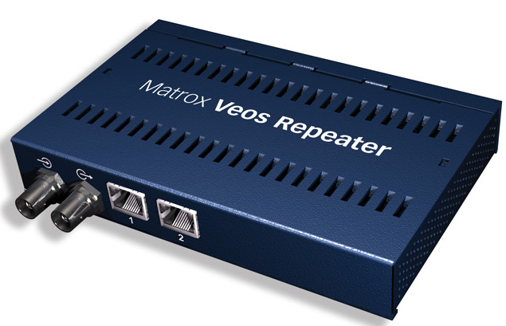
Repeater
The repeater is mainly used to regenerate the signal over the same network and it mainly regenerates before the signal gets corrupted or weak.

Slide 8
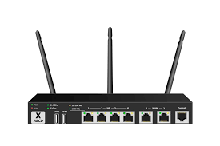
Router
The router is a network component that is mainly used to send or receive data on the computer network. The process of forwarding data packets from the source to the destination is referred to as Routing.
Routers can also connect different networks together and thus data packets can also be sent from one network to another network.
Routers are used in both LAN as well as in WAN(wide area network).

Slide 9
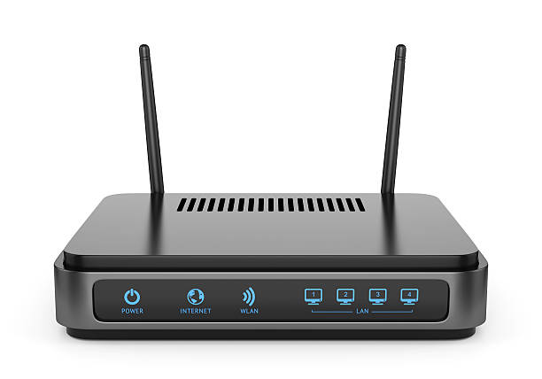
Modem
The modem is basically a hardware component that mainly allows a computer or any other device like a router, switch to connect to the Internet. A modem is basically a shorthand form of Modulator-Demodulator.

Slide 10
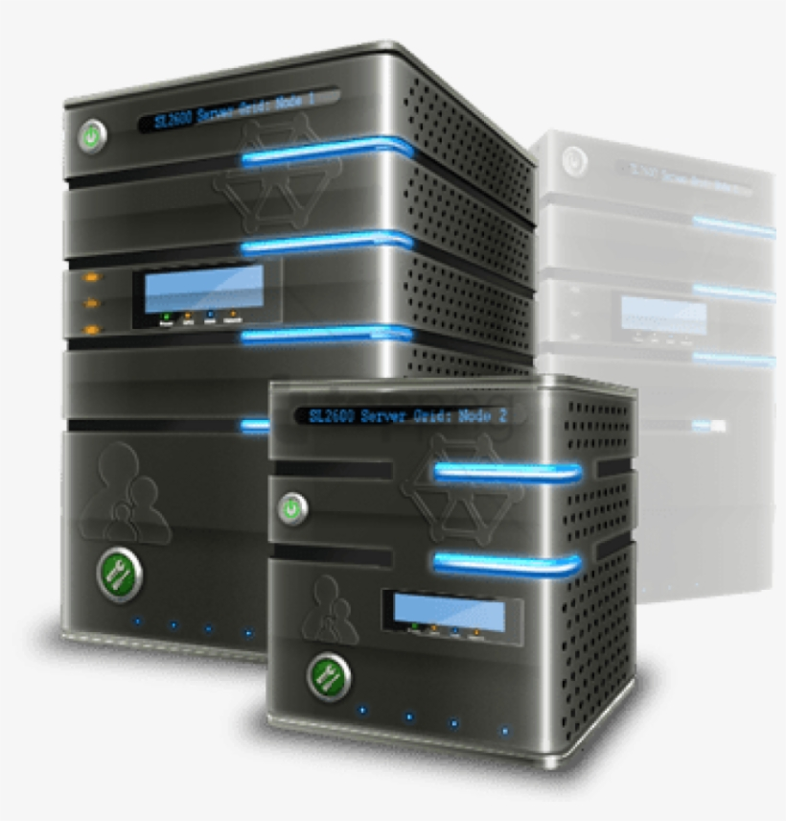
Server
A server is a computer program or device that provides a service to another computer program and its user, also known as the client.

